Slide 1
UNIVERSITY INSTITUTE OF ENGINEERING
COMPUTER SCIENCE ENGINEERING
Master of Engineering
ADVANCED DATA STRUCTURES
&
ALGORITHMS
(23CSH-622)
INTRODUCTION
DISCOVER . LEARN . EMPOWER

Slide 2

ADVANCED DATA STRUCTURES
&
ALGORITHMS
(23CSH-622)
By : Dr. Ranjit Singh (E10947)
www. cuchd.in Campus : Gharaun, Mohali

Slide 3
Contents of the Syllabus
UNIT-I (15h)
Introduction to Basic Data Structures: Importance and need of good data structures and algorithms, Introduction to linear and non-linear data structure and its importance, Algorithms Complexity and Analysis. [3]
Linear and Non –Linear Data Structures : Arrays , Link Lists, Queues , Trees and related algorithms [6]
Advanced Data Structures: AVL Trees (Insertion , Deletion , Searching), Red-Black Trees, B-trees, B+trees, Heaps. Data structure for disjoint sets, Augmented data structures. [6]
UNIT-II (15h)
Searching and Sorting : Internal and External Sorting algorithms: Linear Search, Binary Search, Bubble Sort, Selection Sort, Insertion Sort, Shell Sort, Quick Sort, Heap Sort, Merge Sort, Counting Sort, Radix Sort and analysis of their complexities and Hashing [4]
Graphs & Algorithms: Representation, Type of Graphs, Depth- and breadth-first traversals, Planar graphs, isomorphism, graph coloring, covering and partition, Minimum Spanning Tree: Prim’s and Kruskal’s algorithms. [6]
String Matching Algorithms: Naïve String Matching, Suffix arrays, Suffix trees, Rabin-Karp, Knuth-Morris-Pratt, Booyer-Moore algorithm [5]

Slide 4
Contents of the Syllabus
UNIT-III (15h)
Approximation algorithms: Need of approximation algorithms: Introduction to P, NP, NP-Hard and NP-Complete Greedy Approach, Dynamic Approach, Knapsack, Huffman Coding, TSP, All pair shortest path, Longest Common Subsequence Problem, Matrix Chain Multiplication. [7]
Randomized algorithms: Introduction, type of randomized algorithms, Quick sort, min cut [4]
Online Algorithms: Introduction, Online Paging Problem, k-server Problem. Data compression: Huffman’s coding, BWT, LZW [4]
Recommended Books:
1. Cormen, Leiserson, Rivest, Stein, “Introduction to Algorithms”, Prentice Hall of India, 3rd edition 2012.
2. Horowitz, Sahni and Rajasekaran, “Fundamental of Computer, Algorithms”, University Press (India), 2nd edition.
3. Aho, Haperoft and Ullman, “The Design and analysis of Computer Algorithms”, Pearson Education India.

Slide 5
Contents
Array
Introduction
Need of Array
Array initialization
Operations on Array
Multidimensional Array
Bit Manipulation
Operators

Slide 6
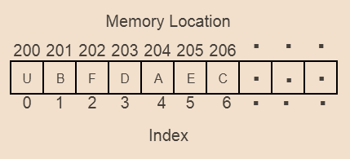
Array
An array is a collection of items stored at contiguous memory locations. The idea is to store multiple items of the same type together.
This makes it easier to calculate the position of each element by simply adding an offset to a base value, i.e., the memory location of the first element of the array (generally denoted by the name of the array).

Slide 7
Why do we need arrays?
Arrays are best for storing multiple values in a single variable
Arrays are better at processing many values easily and quickly
Sorting and searching the values is easier in arrays

Slide 8
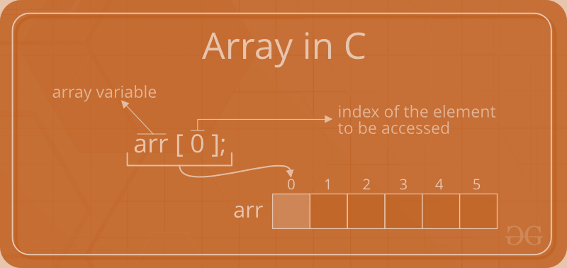
Initialization of Array
int arr[10]; char arr[10]; float arr[5]
A character array in C/C++/Java char
arr1[] = {‘A', ‘R', ‘R', ‘A', ‘Y'};
// An Integer array in C/C++/Java int
arr2[] = {10, 20, 30, 40, 50};
// Item at i'th index in array is typically accessed
// as "arr[i]".
For example arr1[0] gives us ‘A' // and arr2[3] gives us 40.

Slide 9
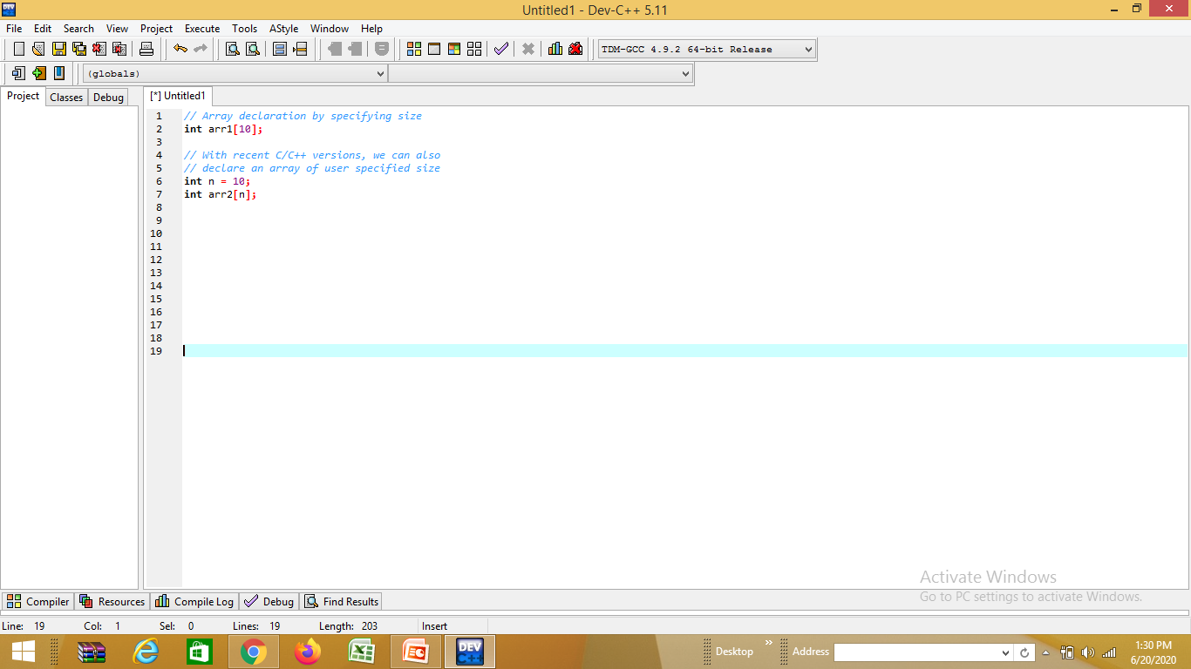
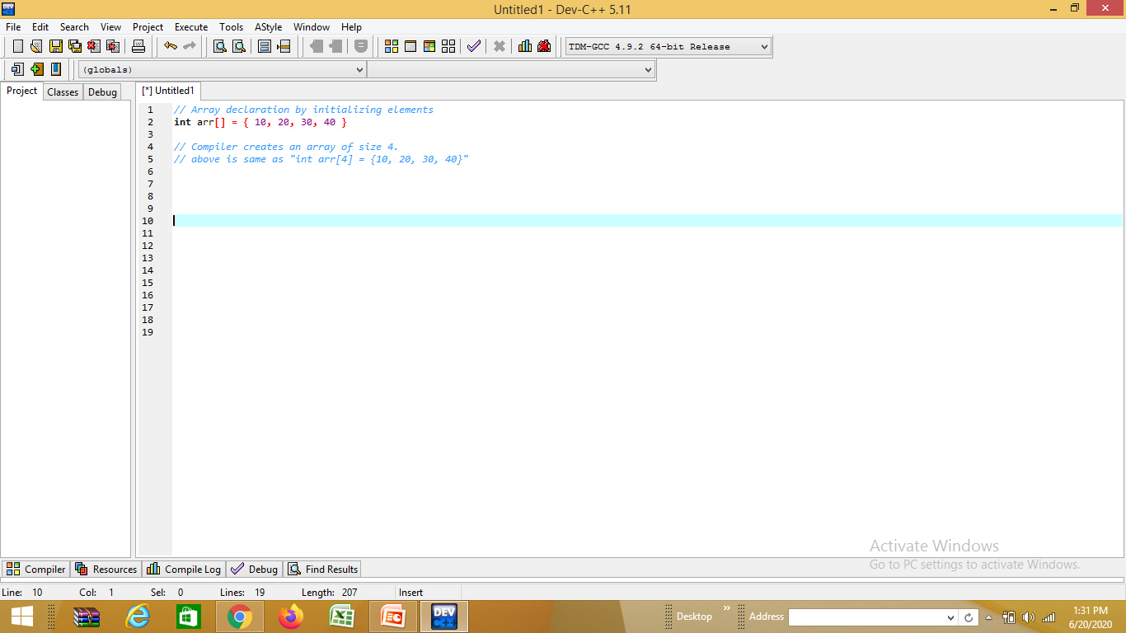
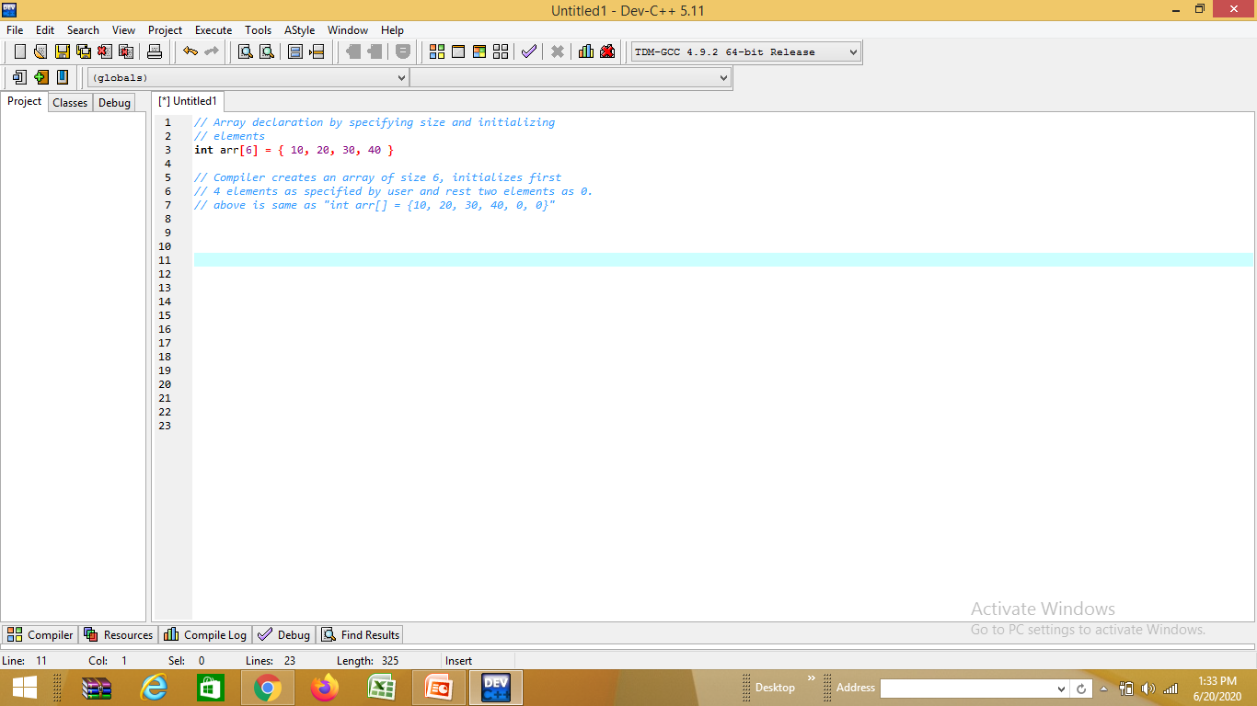
Array declaration

Slide 10
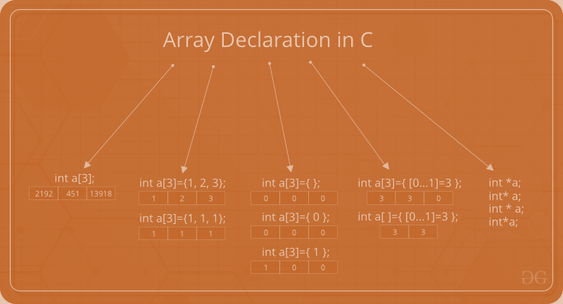
Array declaration in C/C++:

Slide 11
Basic Operations of Array
Traverse − print all the array elements one by one.
Insertion − Adds an element at the given index.
Deletion − Deletes an element at the given index.
Search − Searches an element using the given index or by the value.
Update − Updates an element at the given index.

Slide 12
Traversing
This operation is performed to traverse through the array elements. It prints all array elements one after another.
#include <stdio.h>
void main() {
int Arr[5] = {18, 30, 15, 70, 12};
int i;
printf("Elements of the array are:\n");
for(i = 0; i<5; i++) {
printf("Arr[%d] = %d, ", i, Arr[i]);
}
}

Slide 13
Insertion
This operation is performed to insert one or more elements into the array. As per the requirements, an element can be added at the beginning, end, or at any index of the array.
#include <stdio.h>
int main()
{
int arr[20] = { 18, 30, 15, 70, 12 };
int i, x, pos, n = 5;
printf("Array elements before insertion\n");
for (i = 0; i < n; i++)
printf("%d ", arr[i]);
printf("\n");
x = 50; // element to be inserted
pos = 4;
n++;

Slide 14

for (i = n-1; i >= pos; i--)
arr[i] = arr[i - 1];
arr[pos - 1] = x;
printf("Array elements after insertion\n");
for (i = 0; i < n; i++)
printf("%d ", arr[i]);
printf("\n");
return 0;
}

Slide 15
Deletion
This operation removes an element from the array and then reorganizes all of the array elements.
#include <stdio.h>
void main() {
int arr[] = {18, 30, 15, 70, 12};
int k = 30, n = 5;
int i, j;
printf("Given array elements are :\n");
for(i = 0; i<n; i++) {
printf("arr[%d] = %d, ", i, arr[i]);
}
j = k;

Slide 16

while( j < n) {
arr[j-1] = arr[j];
j = j + 1;
}
n = n -1;
printf("\nElements of array after deletion:\n");
for(i = 0; i<n; i++) {
printf("arr[%d] = %d, ", i, arr[i]);
}
}

Slide 17
Search
This operation is performed to search an element in the array based on the value or index.
#include <stdio.h>
void main() {
int arr[5] = {18, 30, 15, 70, 12};
int item = 70, i, j=0 ;
printf("Given array elements are :\n");
for(i = 0; i<5; i++) {
printf("arr[%d] = %d, ", i, arr[i]);
}

Slide 18

printf("\nElement to be searched = %d", item);
while( j < 5){
if( arr[j] == item ) {
break;
}
j = j + 1;
}
printf("\nElement %d is found at %d position", item, j+1); }

Slide 19
Update
This operation is performed to update an existing array element located at the given index.
#include <stdio.h>
void main() {
int arr[5] = {18, 30, 15, 70, 12};
int item = 50, i, pos = 3;
printf("Given array elements are :\n");
for(i = 0; i<5; i++) {
printf("arr[%d] = %d, ", i, arr[i]);
}

Slide 20

arr[pos-1] = item;
printf("\nArray elements after updation :\n");
for(i = 0; i<5; i++) {
printf("arr[%d] = %d, ", i, arr[i]);
}
}

Slide 21
Multidimensional Arrays
Arrays with more than one index
number of dimensions = number of indexes
Arrays with more than two dimensions are a simple extension of two-dimensional (2-D) arrays
A 2-D array corresponds to a table or grid
one dimension is the row
the other dimension is the column
cell: an intersection of a row and column
an array element corresponds to a cell in the table

Slide 22
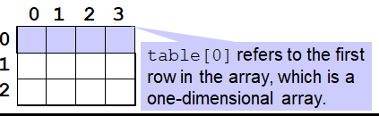
Implementation of Multidimensional Arrays
Multidimensional arrays are implemented as arrays of arrays.
Example:
int[][] table = new int[3][4];
table is a one-dimensional array of length 3
Each element in table is an array with base type int.
Access a row by only using only one subscript:
table[0].length gives the length (4) of the first row in the array
Note: table.length (which is 3 in this case) is not the same thing as table[0].length (which is 4).

Slide 23
Linked List

Slide 24
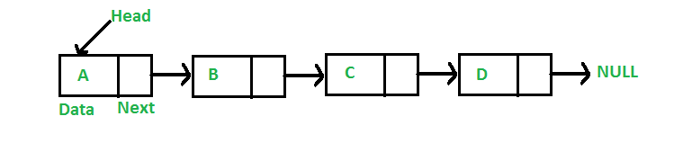
WHAT IS LINKED LIST
A linked list is a linear data structure, in which the elements are not stored at contiguous memory locations. The elements in a linked list are linked using pointers as shown in the below image:
In simple words, a linked list consists of nodes where each node contains a data field and a reference(link) to the next node in the list.

Slide 25
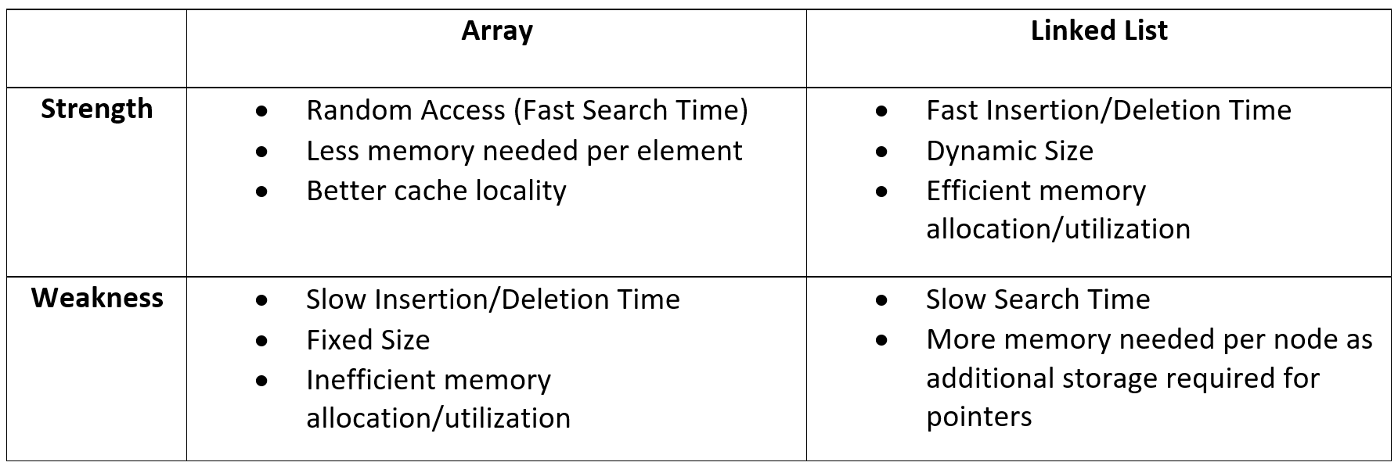
LINKED LIST V/S ARRAY

Slide 26
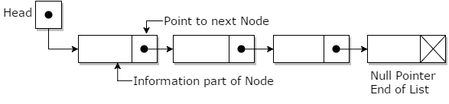
LINKED LIST
Each node is separated into two different parts:
The first part holds the information of the element or node
The second piece contains the address of the next node (link / next-pointer field) in this structure list.

Slide 27
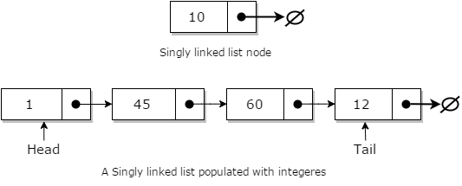
SINGLY LINKED LIST
Singly linked lists are one of the most primitive data structures. Here each node makes up a singly linked list and consists of a value and a reference to the next node (if any) in the list.

Slide 28
SINGLY LINKED LIST -INSERTION
In general, when people talk about insertion concerning linked lists of any form, they implicitly refer to the adding of a node to the tail of the list.
Adding a node to a singly linked list has only two cases:
head = fi, in which case the node we are adding is now both the head and tail of the list; or
we simply need to append our node onto the end of the list updating the tail reference appropriately

Slide 29
SINGLY LINKED LIST -INSERTION
// A linked list node
class Node
{ public:
int data;
Node *next;
};
A node can be added in three ways:
1) At the front of the linked list
2) After a given node.
3) At the end of the linked list.

Slide 30
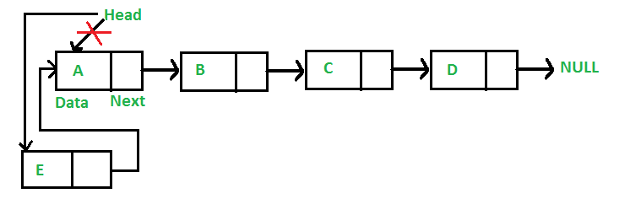
SINGLY LINKED LIST -INSERTION

Slide 31
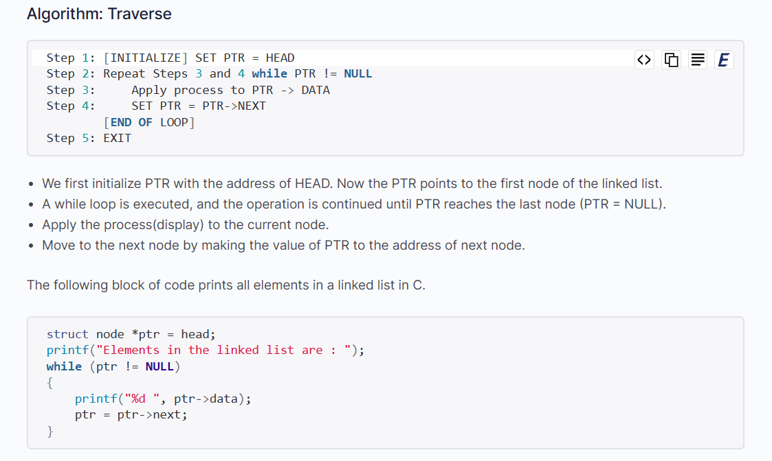

Slide 32
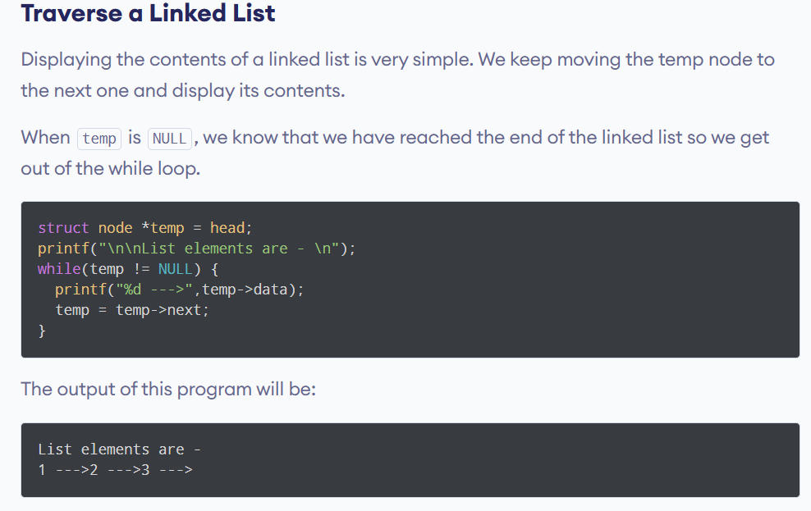

Slide 33
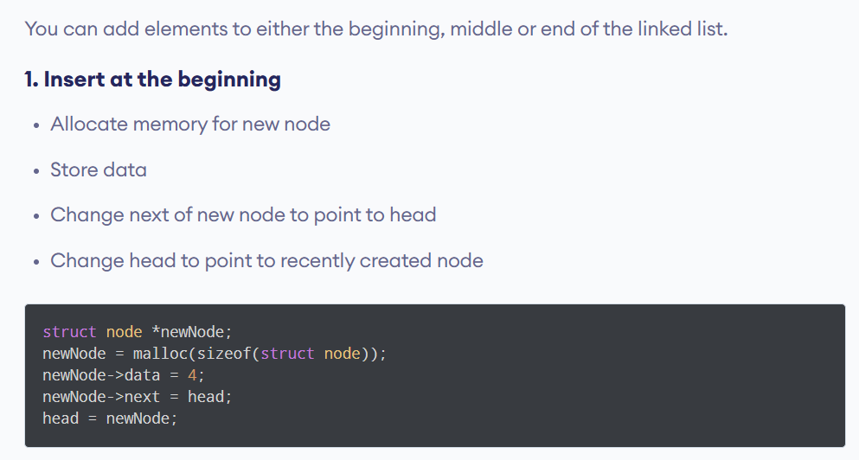

Slide 34
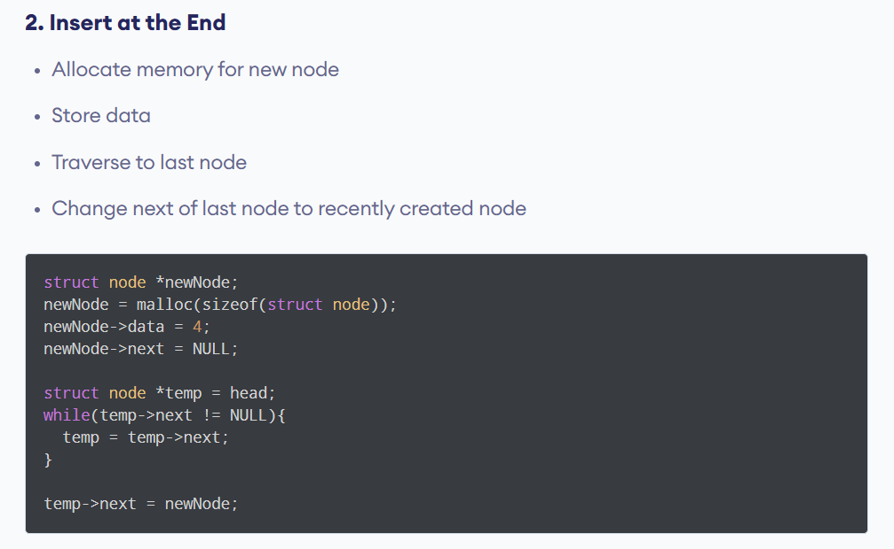

Slide 35
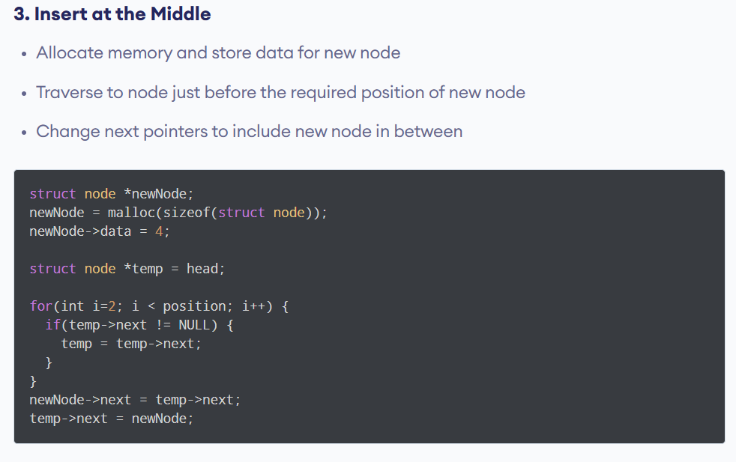

Slide 36
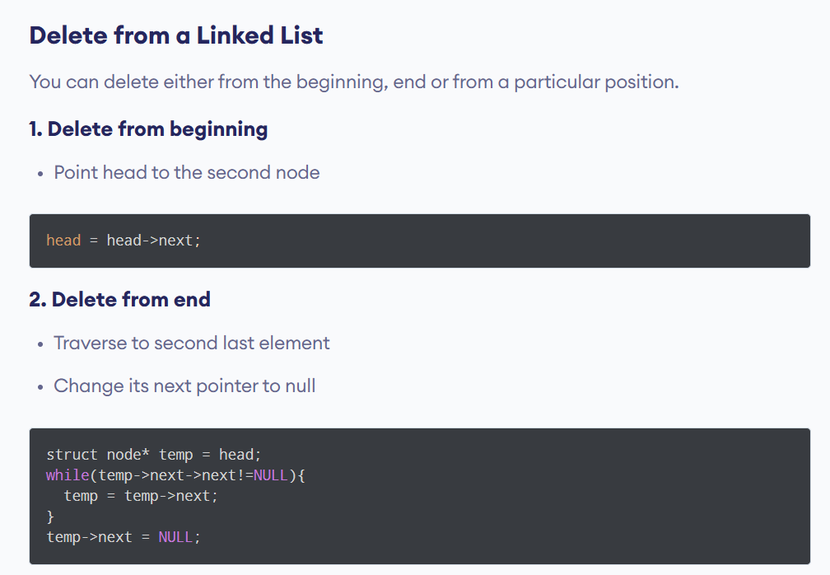

Slide 37
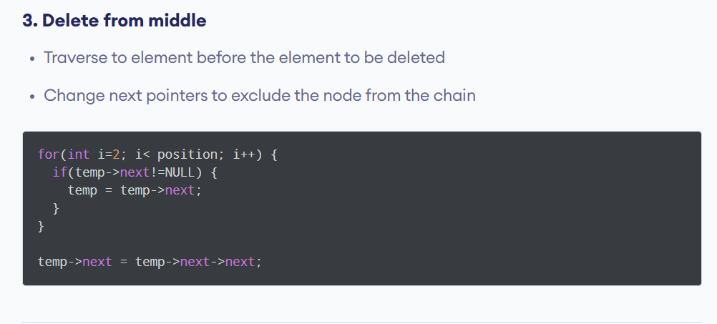

Slide 38
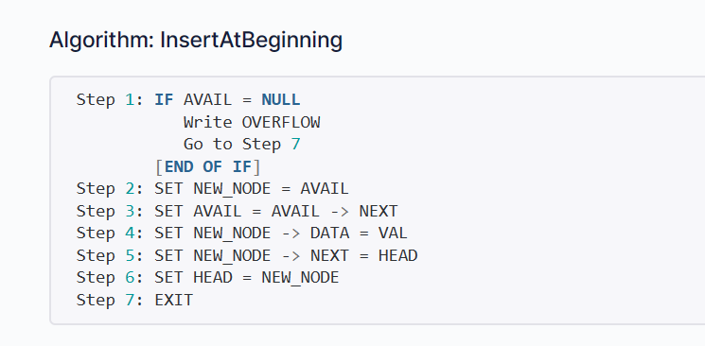
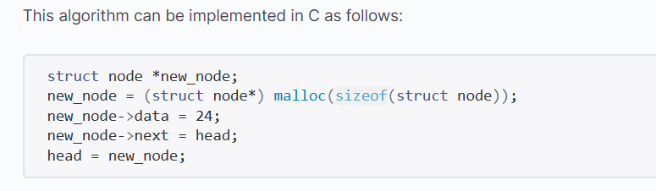

Slide 39
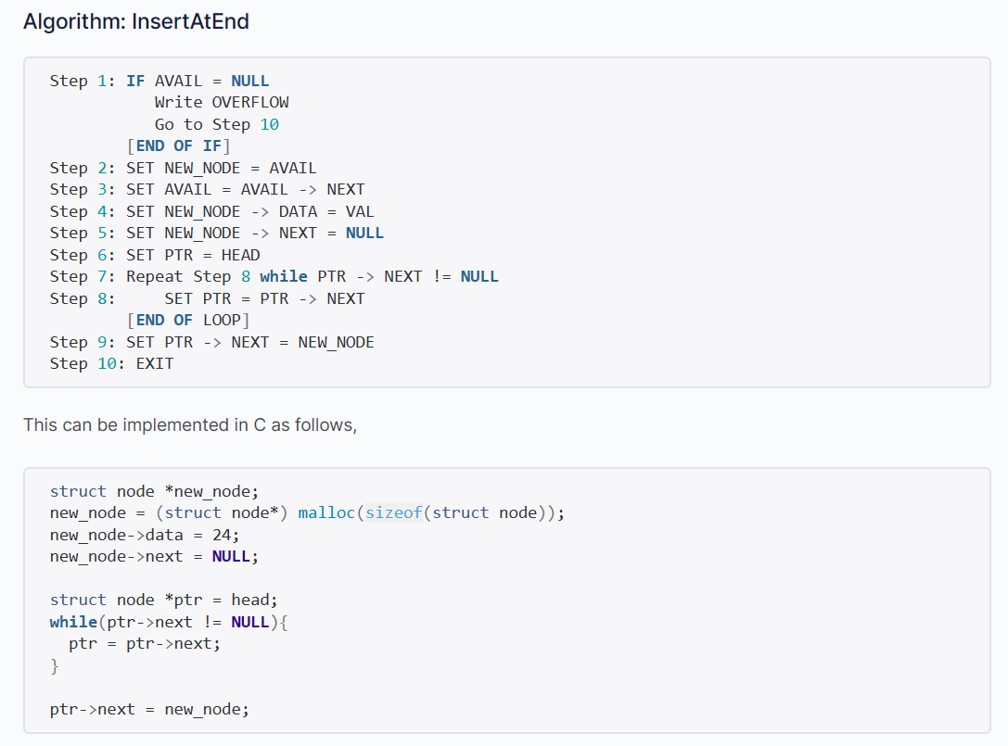

Slide 40
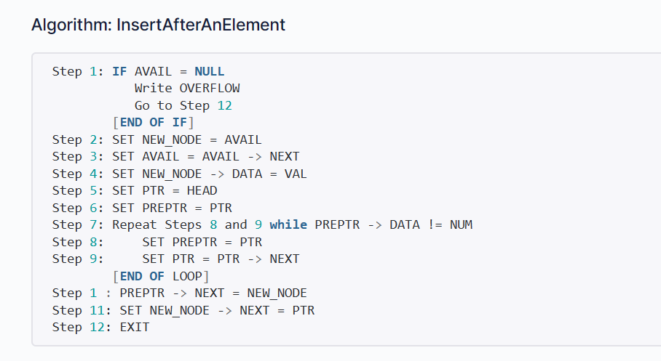

Slide 41
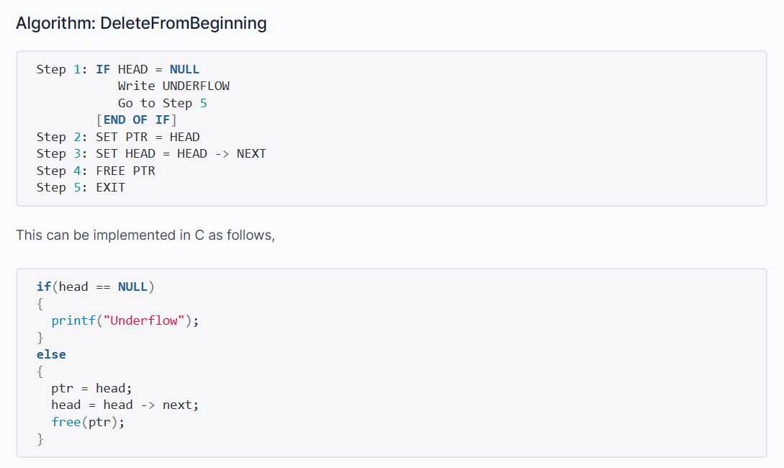

Slide 42
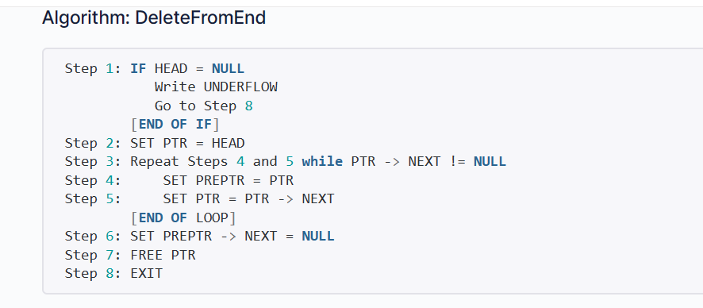

Slide 43
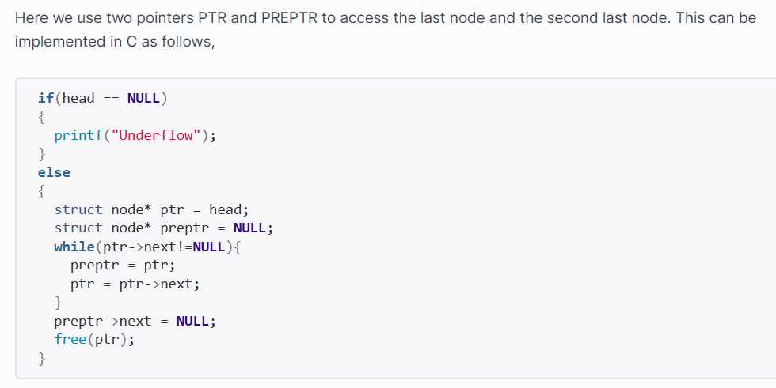

Slide 44
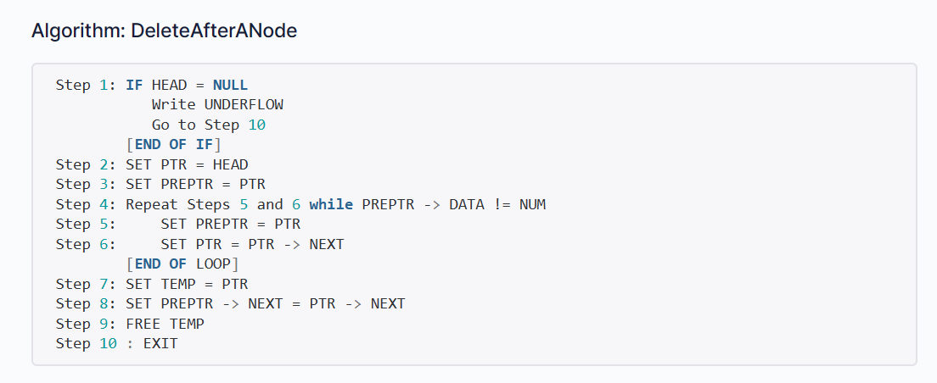

Slide 45
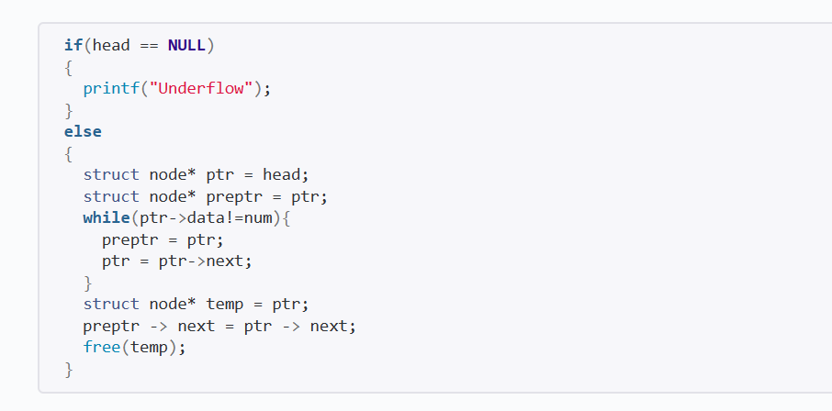

Slide 46
Circular Linked List
In a circular linked list, the last node contains a pointer to the first node of the list. We can have a circular singly listed list as well as circular doubly linked list. While traversing a circular linked list, we can begin at any node and traverse the list in any direction forward or backward until we reach the same node where we had started. Thus, a circular linked list has no beginning and no ending.
START
1
2
3
4
5
6
7

Slide 47
Circular Linked List
Algorithm to insert a new node in the beginning of circular the linked list
Step 1: IF AVAIL = NULL, then
Write OVERFLOW
Go to Step 7
[END OF IF]
Step 2: SET New_Node = AVAIL
Step 3: SET AVAIL = AVAIL->NEXT
Step 4: SET New_Node->DATA = VAL
Step 5: SET PTR = START
Step 6: Repeat Step 7 while PTR->NEXT != START
Step 7: PTR = PTR->NEXT
Step 8: SET New_Node->Next = START
Step 8: SET PTR->NEXT = New_Node
Step 6: SET START = New_Node
Step 7: EXIT

Slide 48
Circular Linked List
1
7
3
4
2
6
5
START, PTR
1
7
3
4
2
6
5
9
START
PTR

Slide 49
DOUBLY LINKED LIST
Doubly Linked List is a variation of Linked list in which navigation is possible in both ways, either forward and backward easily as compared to Single Linked List. Following are the important terms to understand the concept of doubly linked list.
Data − Each link of a linked list can store a data called an element.
Next − Each link of a linked list contains a link to the next link called Next.
Prev − Each link of a linked list contains a link to the previous link called Prev.

Slide 50
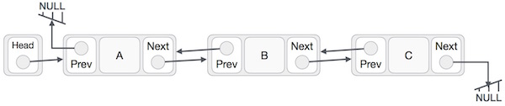
DOUBLY LINKED LIST
As per the above illustration, following are the important points to be considered.
Doubly Linked List contains a link element called first and last.
Each link carries a data field(s) and two link fields called next and prev.
Each link is linked with its next link using its next link.
Each link is linked with its previous link using its previous link.
The last link carries a link as null to mark the end of the list.

Slide 51
Stack and Queue

Slide 52

Basic Operations of Stack
push() − Pushing (storing) an element on the stack.
pop() − Removing (accessing) an element from the stack.
When data is PUSHed onto stack.
To use a stack efficiently, we need to check the status of stack as well. For the same purpose, the following functionality is added to stacks −
peek() − get the top data element of the stack, without removing it.
isFull() − check if stack is full.
isEmpty() − check if stack is empty.

Slide 53
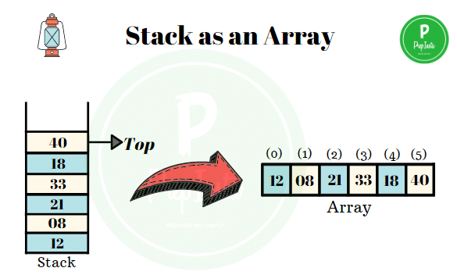
Representation of a Stack as an Array
An array is used to store an ordered list of elements. Using an array for representation of stack is one of the easy techniques to manage the data.

Slide 54
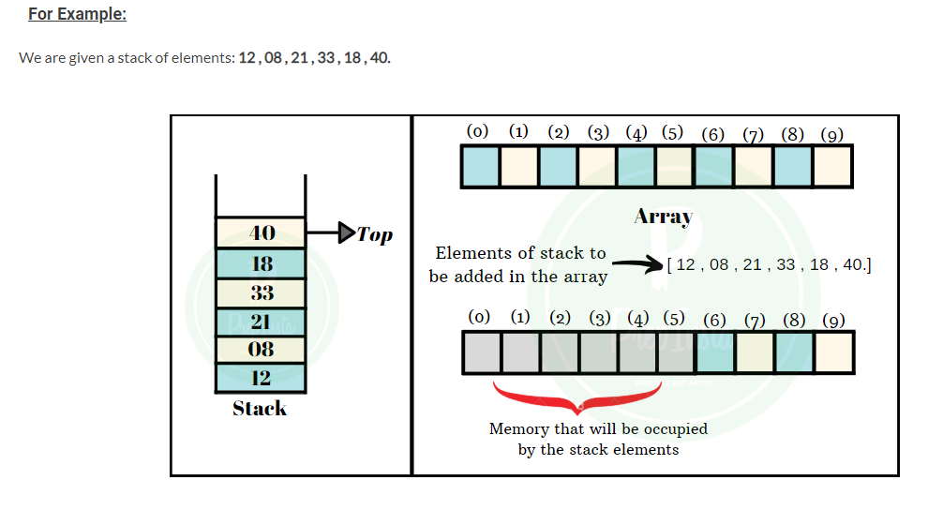

Slide 55
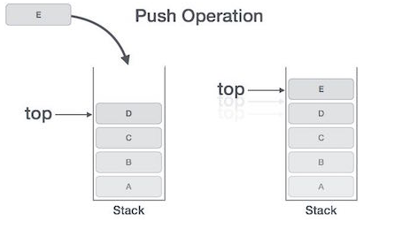
Push Operation
The process of putting a new data element onto stack is known as a Push Operation. Push operation involves a series of steps −
Step 1 − Checks if the stack is full.
Step 2 − If the stack is full, produces an error and exit.
Step 3 − If the stack is not full, increments top to point next empty space.
Step 4 − Adds data element to the stack location, where top is pointing.
Step 5 − Returns success.

Slide 56
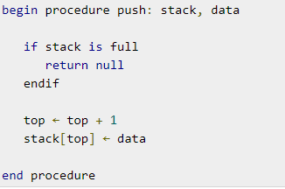
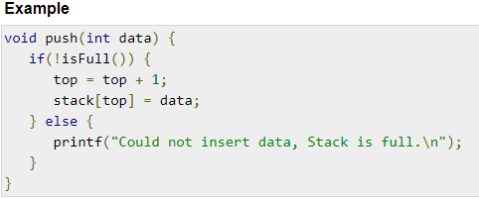
Algorithm and Program for PUSH Operation

Slide 57
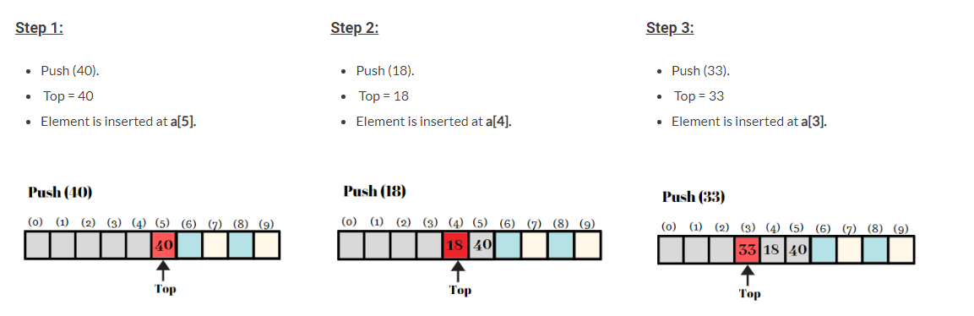
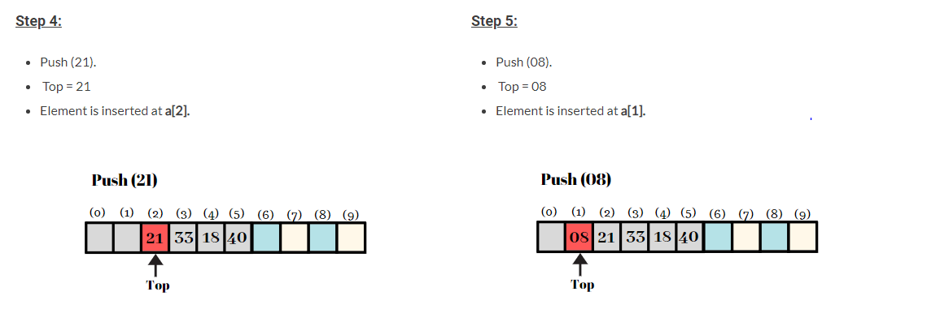

Slide 58
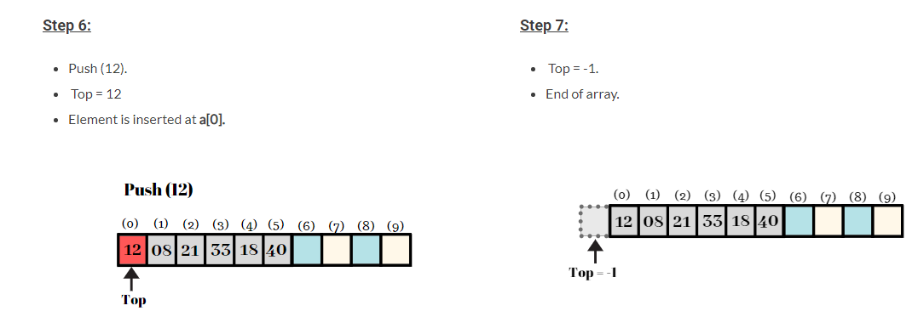
Output:
Push(8),Push(3),Pop(),Push(2),Push(5),Pop(),Pop(),Push(9),Push(1)

Slide 59
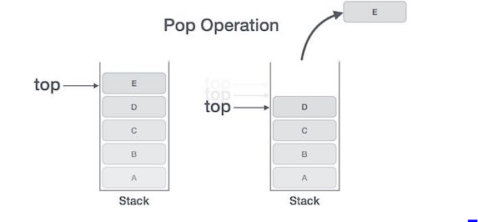
Pop Operation
Accessing the content while removing it from the stack, is known as a Pop Operation. In an array implementation of pop() operation, the data element is not actually removed, instead top is decremented to a lower position in the stack to point to the next value. But in linked-list implementation, pop() actually removes data element and de allocates memory space.
A Pop operation may involve the following steps −
Step 1 − Checks if the stack is empty.
Step 2 − If the stack is empty, produces an error and exit.
Step 3 − If the stack is not empty, accesses the data element at which top is pointing.
Step 4 − Decreases the value of top by 1.
Step 5 − Returns success.

Slide 60
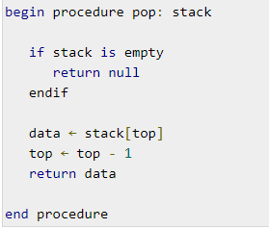
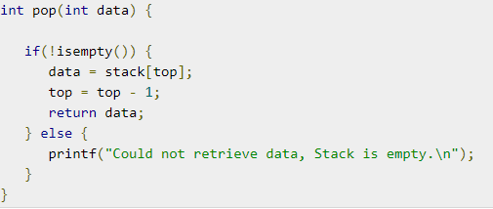
Algorithm and Program for POP

Slide 61
Stack Using Linked List
The major problem with the stack implemented using an array is, it works only for a fixed number of data values.
That means the amount of data must be specified at the beginning of the implementation itself.
Stack implemented using an array is not suitable, when we don't know the size of data which we are going to use.
A stack data structure can be implemented by using a linked list data structure.
The stack implemented using linked list can work for an unlimited number of values. That means, stack implemented using linked list works for the variable size of data.
So, there is no need to fix the size at the beginning of the implementation. The Stack implemented using linked list can organize as many data values as we want.

Slide 62
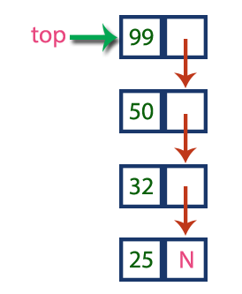
In linked list implementation of a stack, every new element is inserted as 'top' element. That means every newly inserted element is pointed by 'top'. Whenever we want to remove an element from the stack, simply remove the node which is pointed by 'top' by moving 'top' to its previous node in the list. The next field of the first element must be always NULL

Slide 63
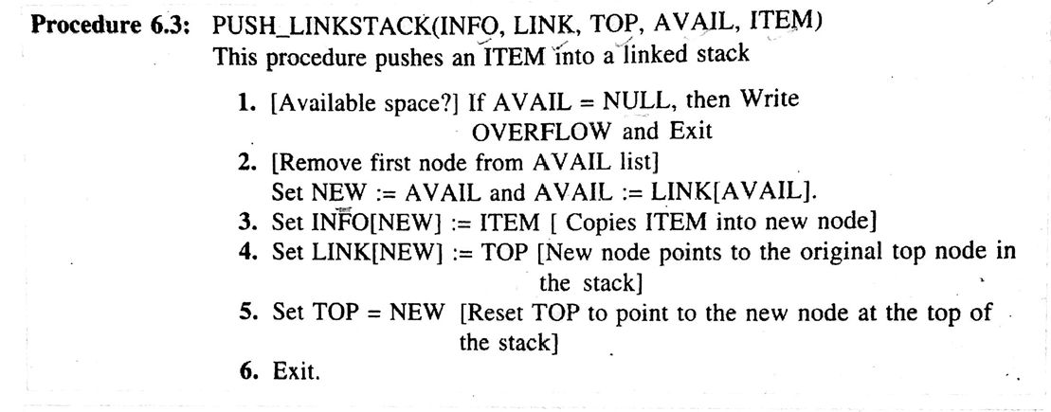
push(value) – Inserting an element into the Stack

Slide 64
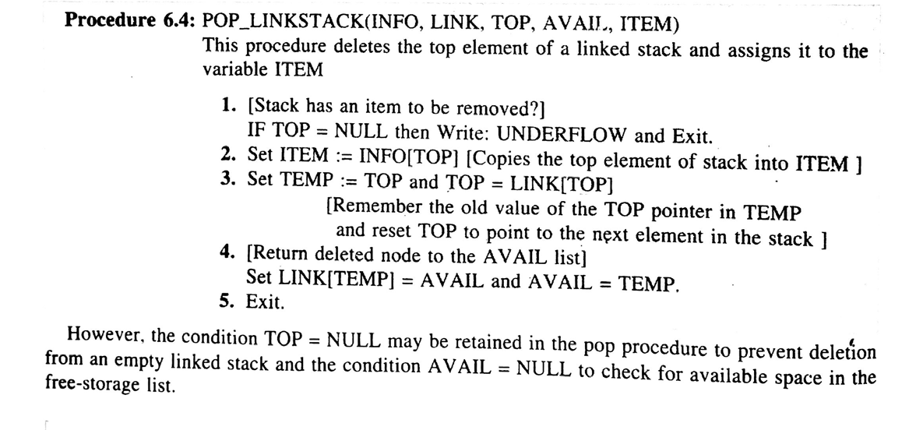
pop() - Deleting an Element from a Stack

Slide 65

INTRODUCTION TO QUEUE
A queue is a linear list of elements in which
deletion can take place only at one end called Front, and
Insertion takes place at one end called Rear
Queues are also known as First-In-First-Out (FIFO) list
Operations on Queues:
enqueue() − add (store) an item to the queue.
dequeue() − remove (access) an item from the queue.
Few more functions are required to make the above-mentioned queue operation efficient. These are −
peek() − Gets the element at the front of the queue without removing it.
isfull() − Checks if the queue is full.
isempty() − Checks if the queue is empty.

Slide 66
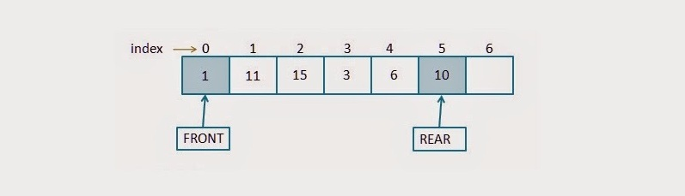
Types of queues
1.Array representation of Queue 2. Linked List Representation of Queue
Array representation of Queue
A queue is maintained by a
linear array QUEUE
Two pointer variable
FRONT : Containing the location of the front element of the queue
REAR : Containing
FRONT == NULL indicates that the queue is empty

Slide 67
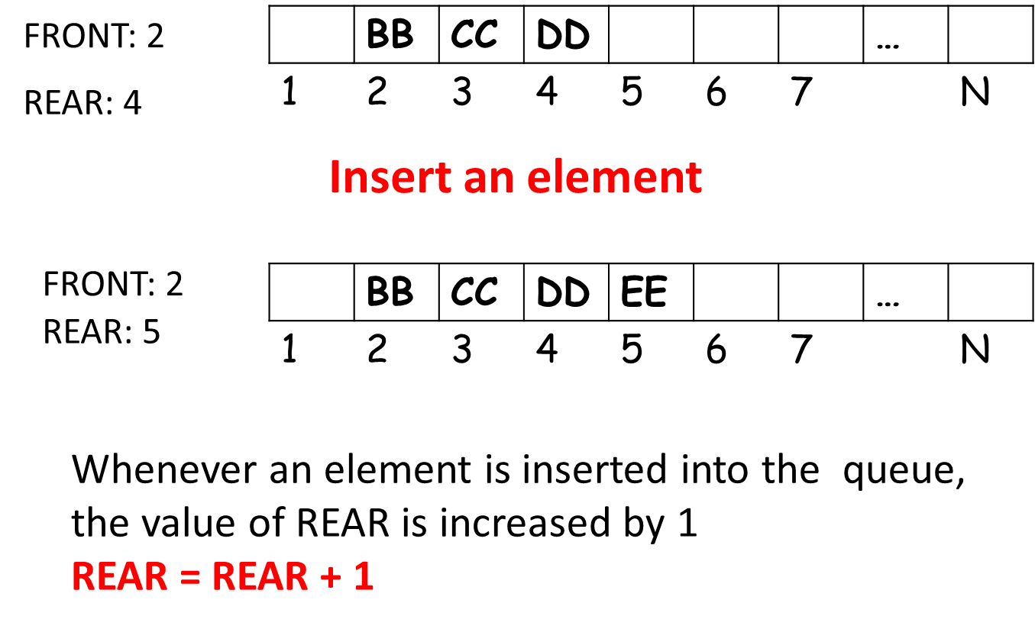
Enqueue Operation

Slide 68
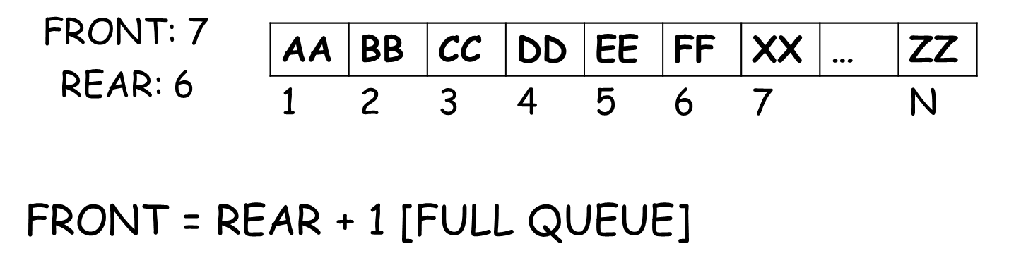
Algorithm for Insertion in Queue
QINSERT(QUEUE,N,FRONT,REAR,ITEM)
This procedure inserts an element ITEM into a queue
1. [Queue already filled?]
If FRONT = 1 and REAR = N or if FRONT = REAR + 1 then
Print: Overflow and Exit
2. [Find new value of REAR]
If FRONT = NULL then [Queue initially empty]
Set FRONT = 1 and REAR = 1
Else If REAR = N then
Set REAR = 1
Else
Set REAR = REAR + 1
[End of if structure]
[3] Set QUEUE[REAR] = ITEM [This inserts new element]
[4] Exit

Slide 69
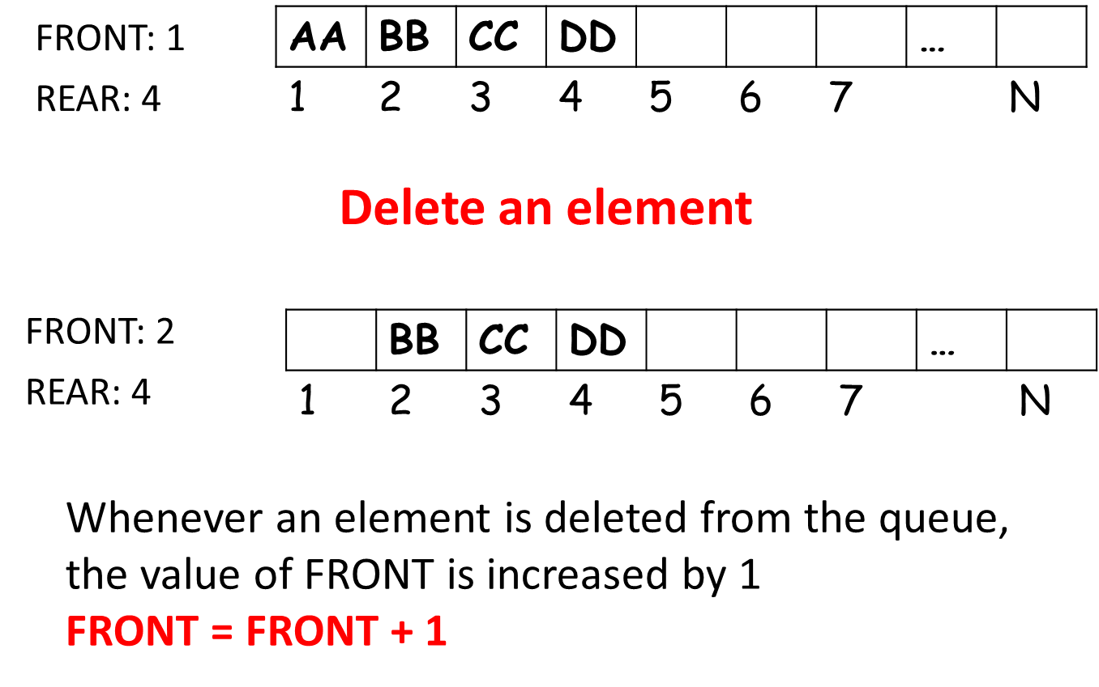
Dequeue Operation

Slide 70
Algorithm to Delete from Q
QDELETE(QUEUE,N,FRONT,REAR,ITEM)
This procedure deletes an element from a queue and assigns it to the variable ITEM
[1] [Queue already empty?]
If FRONT = NULL then Print: Underflow and Exit
[2] Set ITEM = QUEUE[FRONT]
[3] [Find new value of FRONT]
If FRONT = REAR then [Queue has only one element to start]
Set FRONT = NULL and REAR = NULL
Else If FRONT = N then
Set FRONT = 1
Else
Set FRONT = FRONT + 1
[4] Exit

Slide 71
Linked List Representation of Queue
A linked queue is a queue implemented as linked list with two pointer variable FRONT and REAR pointing to the nodes which is in the FRONT and REAR of the queue
The INFO fields of the list hold the elements of the queue
The LINK fields hold pointers to the neighboring elements in the queue.

Slide 72
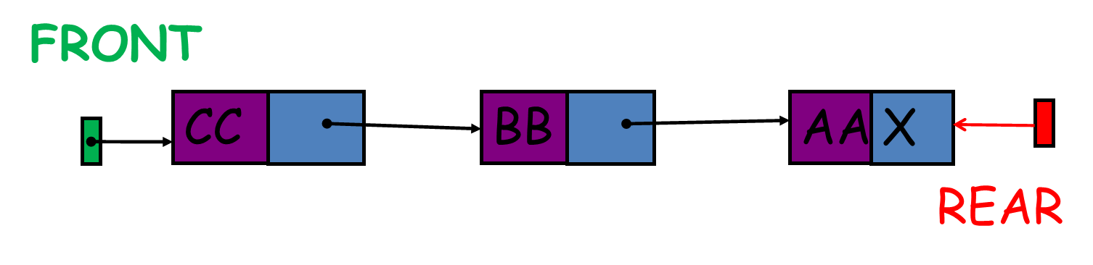
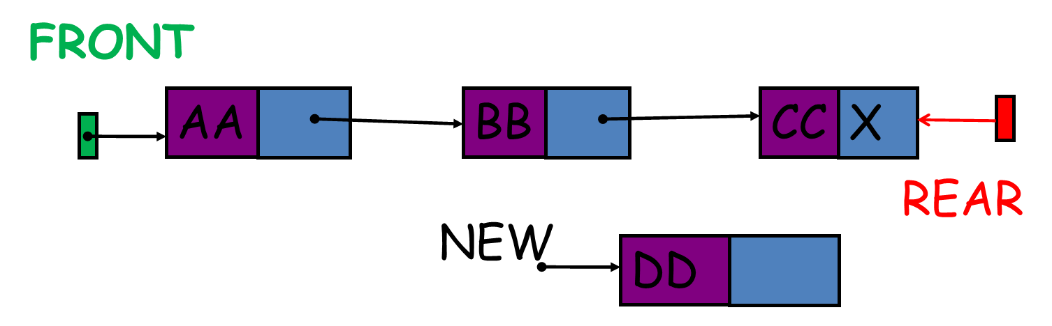
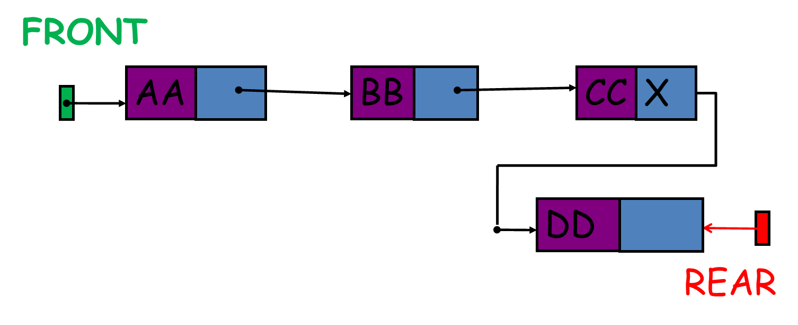
Algorithm for Insertion in Linked Queue
LINKQ_INSERT (INFO, LINK, FRONT, REAR, AVAIL, ITEM)
This procedure inserts an ITEM into a linked queue
[Available space?] If AVAIL=NULL, then
Write OVERFLOW and Exit
2. [Remove first node from AVAIL list]
Set NEW= AVAIL and AVAIL= LINK[AVAIL]
3. Set INFO[NEW]= ITEM and LINK[NEW]= NULL [Copies ITEM into new node]
4. If (FRONT=NULL) then FRONT= REAR= NEW
[If queue is empty then the ITEM is the first element in the queue Q]
Else set LINK[REAR] = NEW and REAR = NEW
[REAR points to the new node appended at the end of the list]
5. Exit

Slide 73

Algorithm for Deletion from Linked Queue
LINKQ_DELETE (INFO, LINK, FRONT, REAR, AVAIL, ITEM)
This procedure deletes the front element of the linked queue and stores it in ITEM
1. [Linked queue empty?] if (FRONT= NULL) then Write UNDERFLOW and Exit
2. Set TEMP= FRONT [If linked queue is nonempty, remember FRONT in a temporary variable TEMP]
3. ITEM= INFO[TEMP]
4. FRONT= LINK[TEMP] [Reset FRONT to point to the next element in the queue]
5. LINK[TEMP]= AVAIL and AVAIL= TEMP [return the deleted node TEMP to the AVAIL list]
6. Exit
Delete element from a Queue

Slide 74

Limitation of Linear Queue
REAR = N and Insert an element into queue
Move the entire queue to the beginning of the array
Change the FRONT and REAR accordingly
Insert the element
This procedure is too expensive

Slide 75

Circular Queue
Circular Queue is a linear data structure in which the operations are performed based on FIFO (First In First Out) principle and the last position is connected back to the first position to make a circle. It is also called ‘Ring Buffer’.
.Queue is assumed to be circular.
.QUEUE[1] comes after QUEUE[N].
.Instead of increasing REAR to N +1, we reset REAR = 1 and then assign
.QUEUE[REAR] = ITEM

Slide 76


Slide 77
Operations on Circular Queue
Front: Get the front item from queue.
Rear: Get the last item from queue.
enQueue(value): This function is used to insert an element into the circular queue. In a circular queue, the new element is always inserted at Rear position.
Steps:
Check whether queue is Full – Check ((rear == SIZE-1 && front == 0) || (rear == front-1)).
If it is full then display Queue is full. If queue is not full then, check if (rear == SIZE – 1 && front != 0) if it is true then set rear=0 and insert element.
deQueue(): This function is used to delete an element from the circular queue. In a circular queue, the element is always deleted from front position.
Steps:
Check whether queue is Empty means check (front==-1).
If it is empty then display Queue is empty. If queue is not empty then step 3
Check if (front==rear) if it is true then set front=rear= -1 else check if (front==size-1), if it is true then set front=0 and return the element.

Slide 78
DEQUE (Double-Ended Queue)
A deque is a linear list in which elements can be added or removed at either end but not in the middle .
Contraction of the name double-ended queue.
Deque is implemented by a circular array DEQUE with pointers LEFT and RIGHT which point to the two ends of the deque.
We assume DEQUE[1] comes after DEQUE[N] in the array

Slide 79




LEFT = NULL indicate deque is empty

Slide 80
PRIORITY QUEUES
A priority queue is a collection of elements such that each elements has been assigned a priority and such that the order in which elements are deleted and processed comes from the following rules:
[1] Elements of higher priority is processed before any elements of lower priority
[2] Two elements with the same priority are processed according to the order in which they were added to the queue
Types of Priority Queue
1.One-Way List Representation of a Priority Queue
[1] Each node in the list will contain three items of information: an information field INFO, a priority number PRN, and a link number LINK
[2] A node X precedes a node Y in the list
(a) when X has higher priority than Y or
(b) when both have same priority but X was added to the list before Y

Slide 81


Example of One-Way List Representation of a Priority Queue
The diagram does not tell us whether BBB was added to the list before of after DDD.
But the diagram does tell us that BBB was inserted before CCC because BBB and CCC have same priority number and BBB appears before CCC in the list
It shows the way the priority queue may appear in memory using linear arrays INFO, PRN and LINK

Slide 82
Insertion Algorithm Deletion Algorithm of Priority Queue
This algorithm add an ITEM with priority number M to a priority queue maintained by a two-dimensional array QUEUE.
[1] Insert ITEM as the rear element in row M of QUEUE
[2] Exit
This algorithm deletes and processes the first element in a priority queue maintained by a two-dimensional array QUEUE.
[1] [Find the first nonempty queue]
Find the smallest K such that FRONT[K] ≠ NULL
[2] Delete and process the front element in row K of QUEUE
[3] Exit

Slide 83
Thank you

